Slide 1
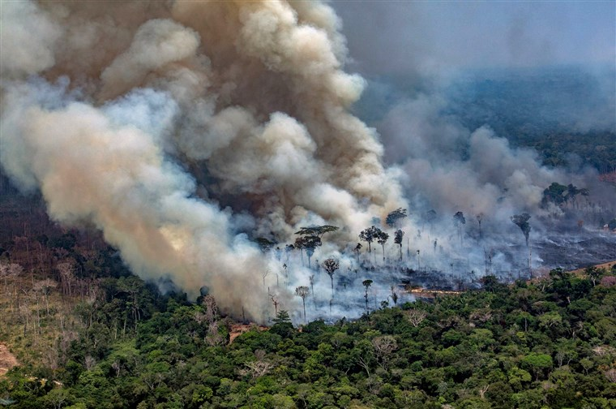
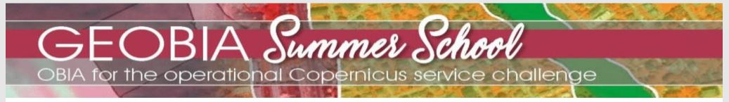

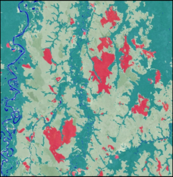
APPLICATION OF OBIA TO ANALYZE FOREST FIRES IN THE BOLIVIAN AMAZON REGION
¹Sayana, G., ¹Leonard L., Maliha M.M., ²Jenny C.F.V., & ³Rabindra A.
¹ University of Salzburg, Salzburg, Austria
² University of Applied Sciences, Villach, Austria
³Tribhuvan University, Institute of Forestry, Pokhara, Nepal

Slide 2
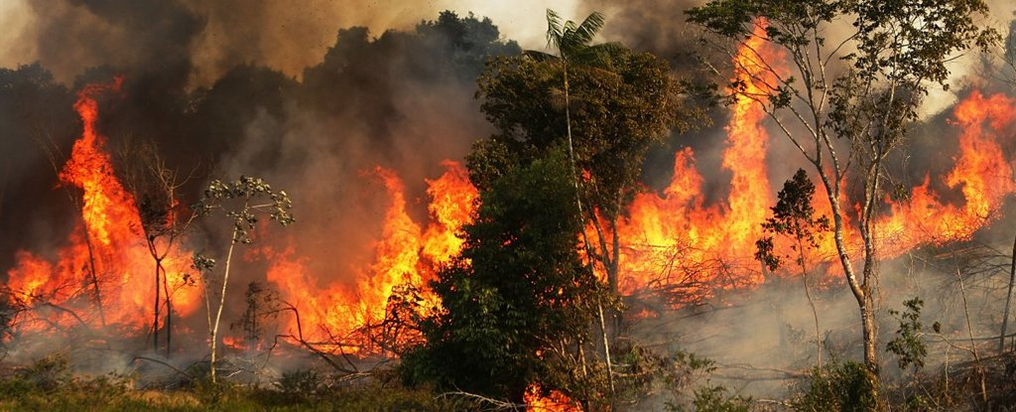
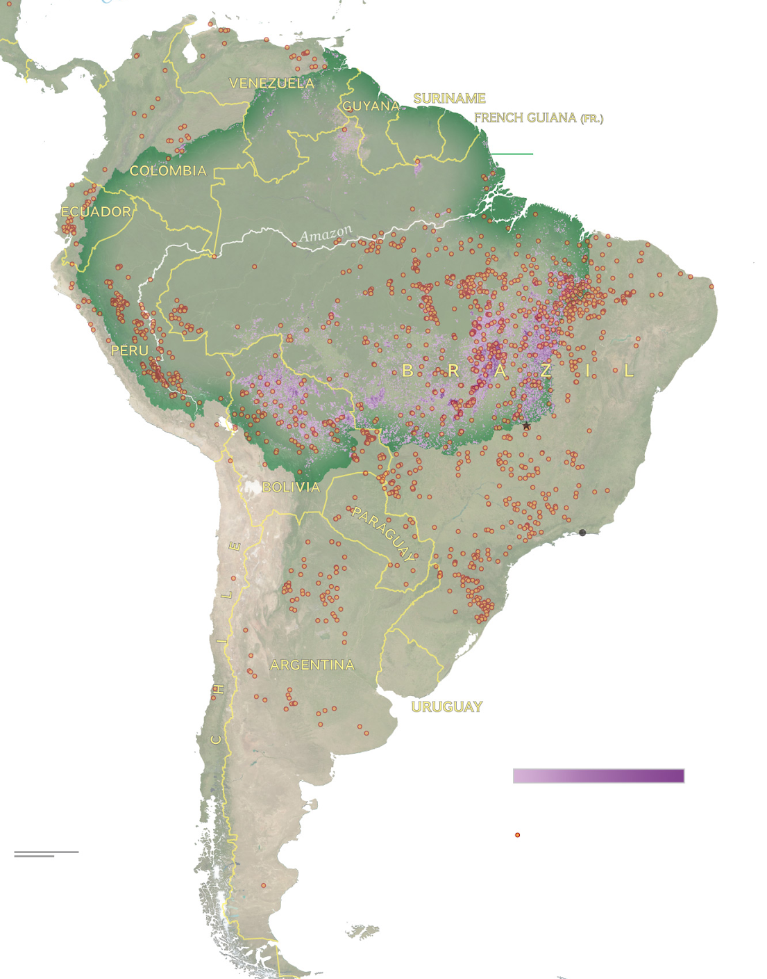
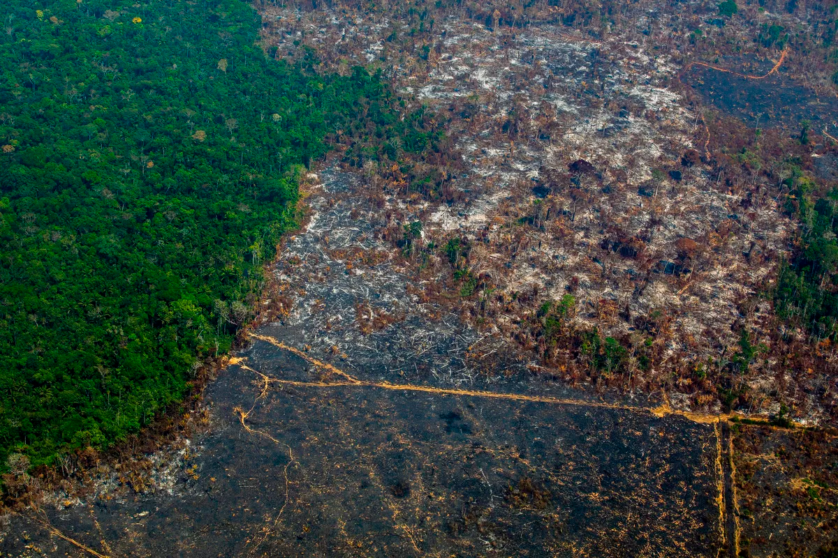
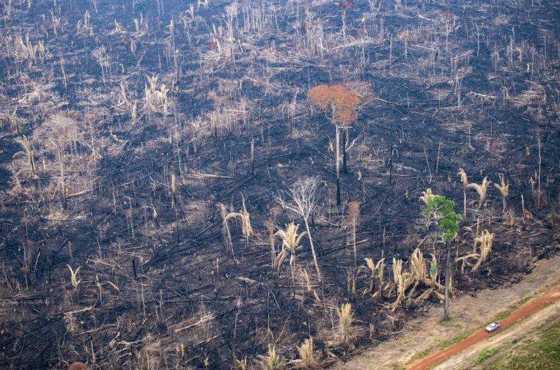
1
4
2
3
Images: 1. hwnews.in, 2. Vox.com, 3. medium.com 4. National Geographic

Slide 3
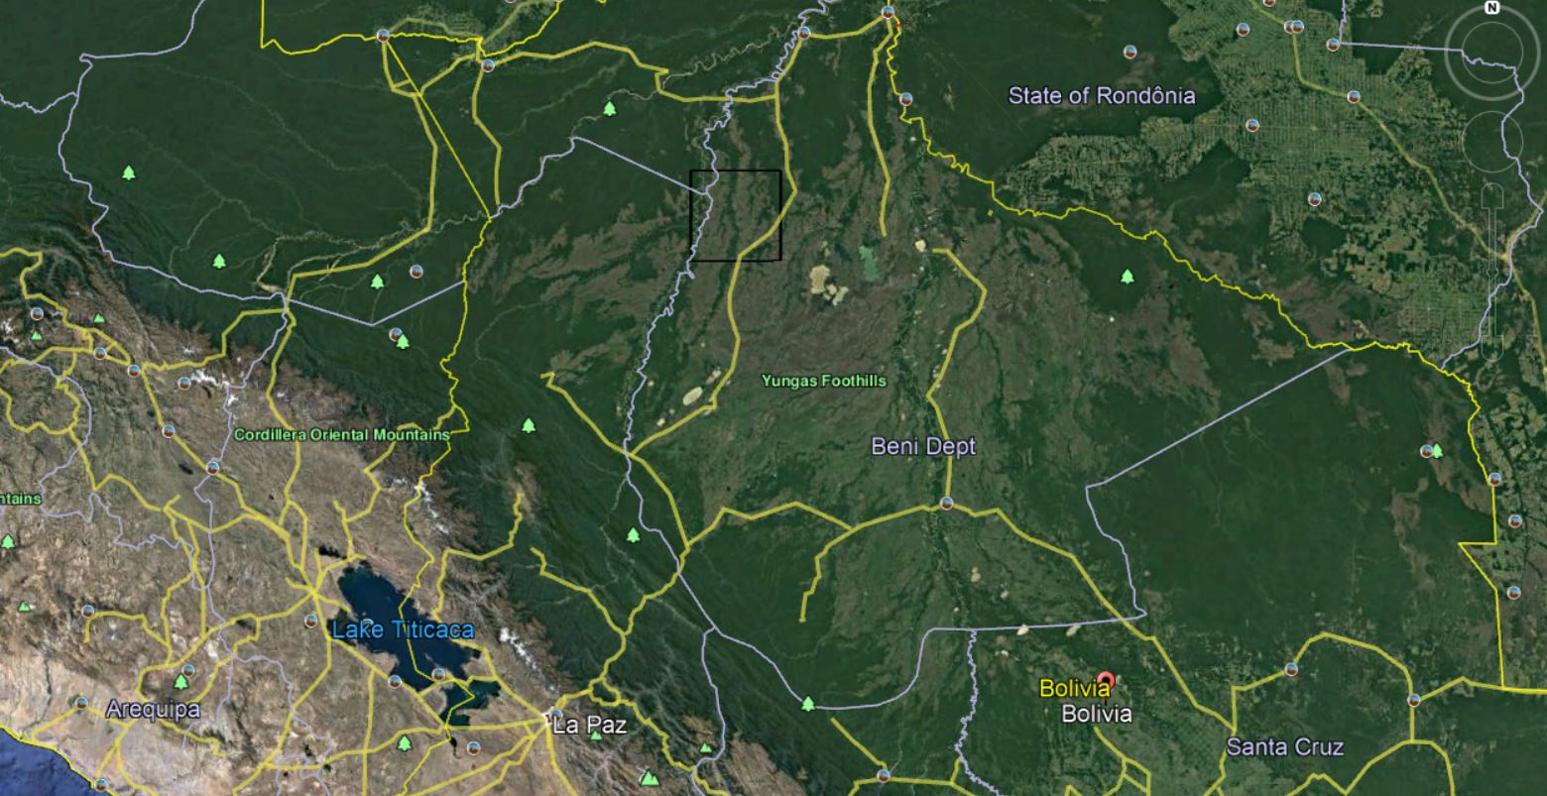
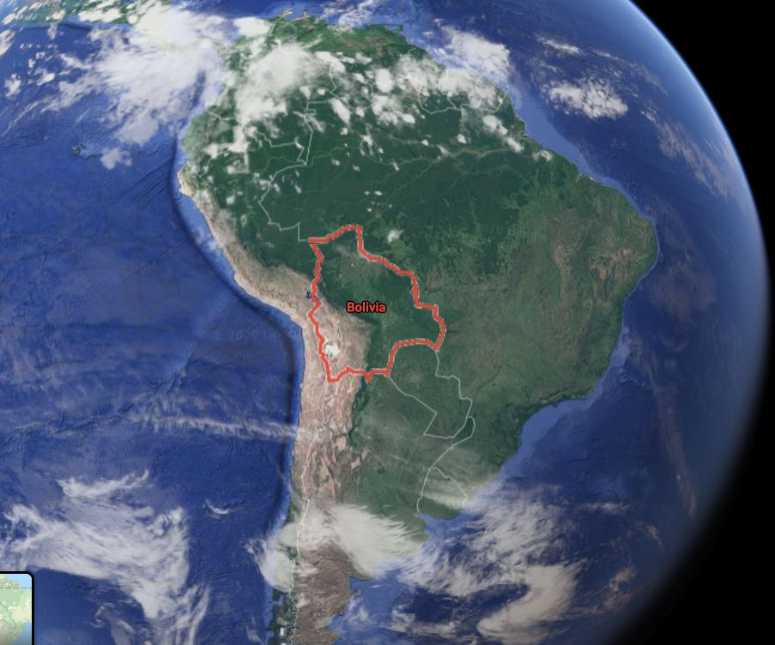
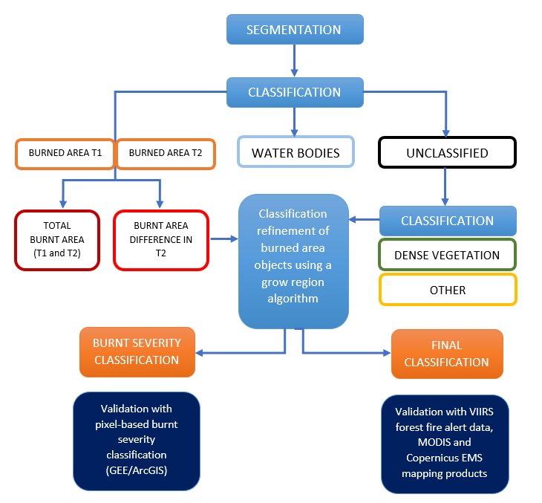
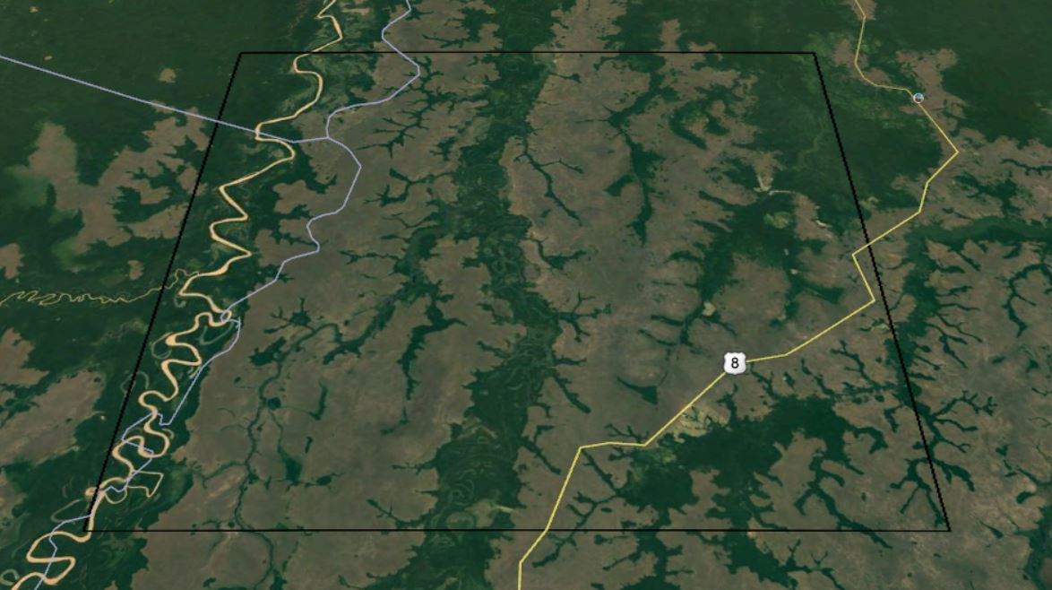
Acquisition dates:
July 28th, 2019
August 22nd, 2019
Bolivia near Borochi – in the Yungus foothill

Slide 4
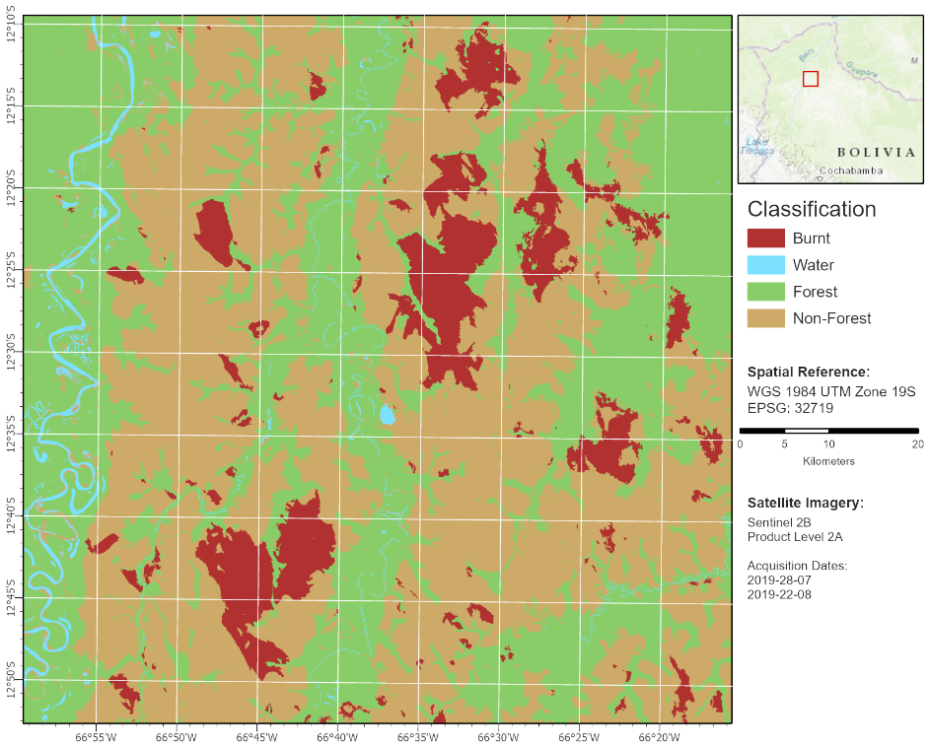
Burnt area calculation
Area | Ha
Forest T1 | 291.300
Burnt T1 | 54.700
Burnt T2 | 56.300
Burnt Forest | 340
Notes:
Burnt
Burnt_ForestBurnt_Forest

Slide 5
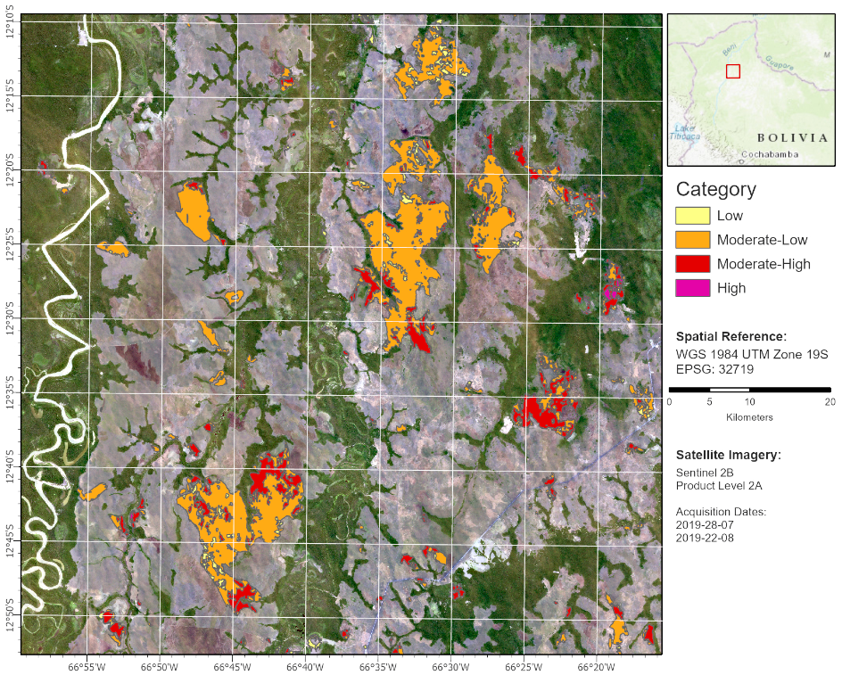
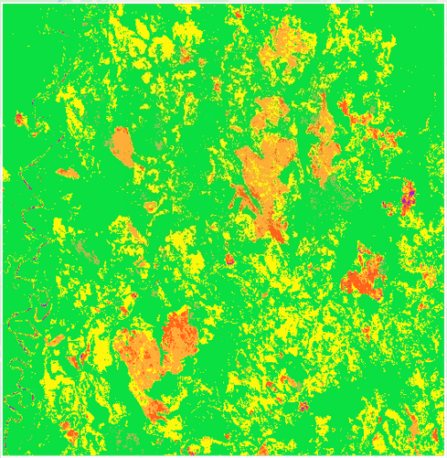
Severity Map
USGS Wildfire severity levels
Object-based burnt severity classification (eCognition)
Pixel-based burnt severity classification
(Google Earth Engine)

Slide 6
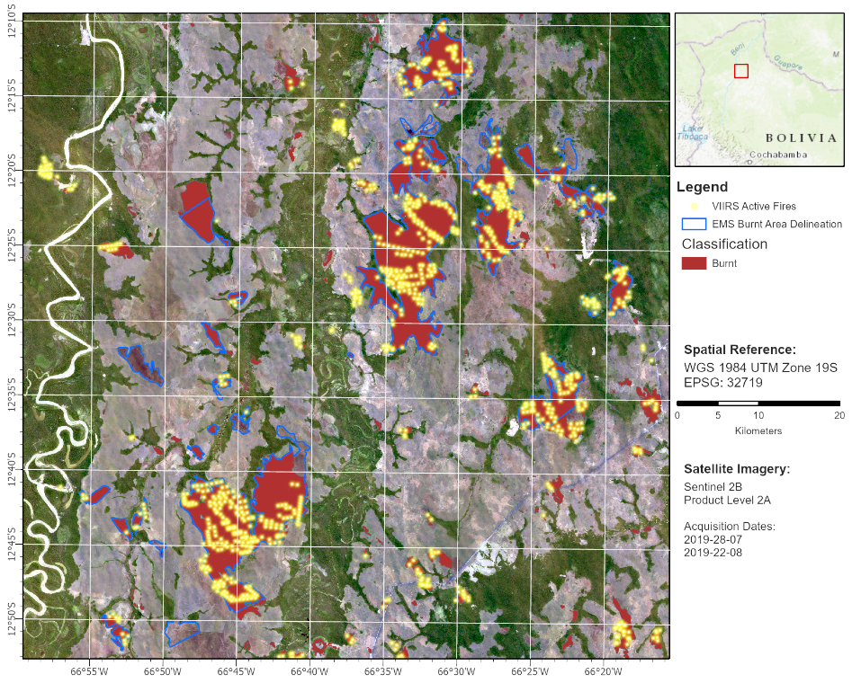
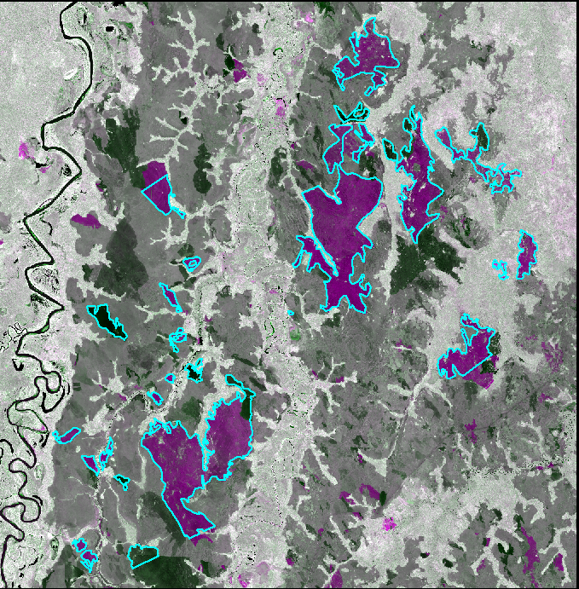
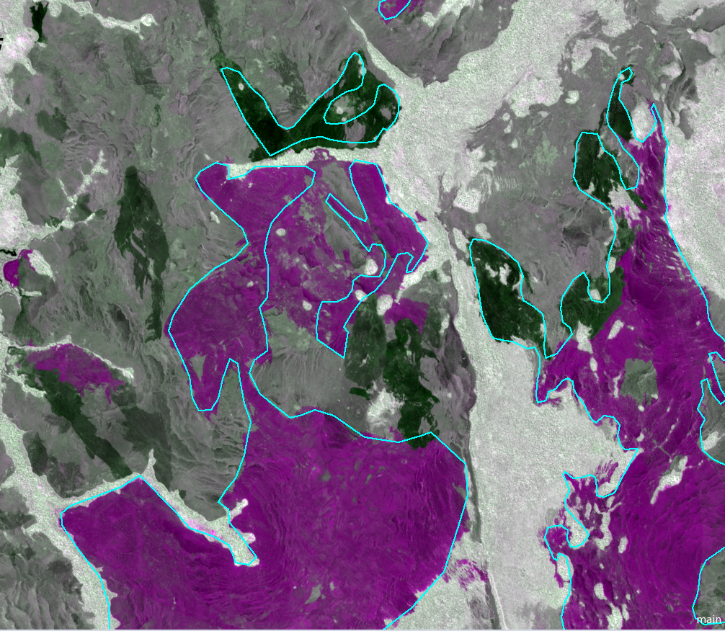
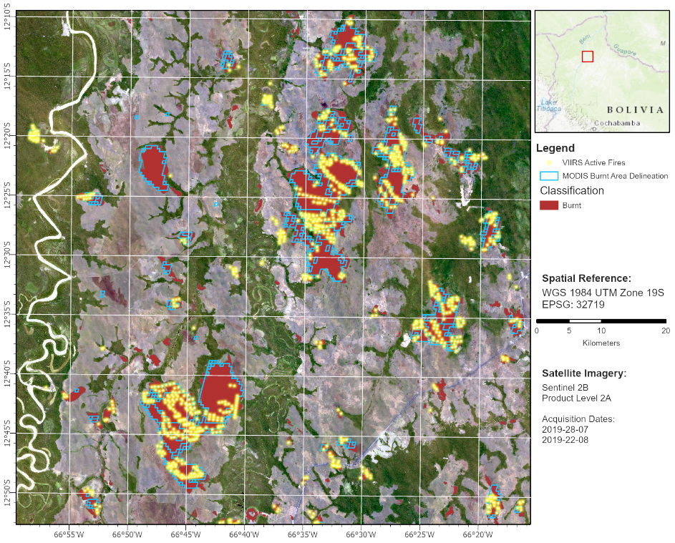
Validation
Burnt area with EMS delineation and VIIRS Active Fires
Accuracy assessment (kappa) : 0.74
Over and underestimation of the EMS product
EMS
Burnt area with MODIS MCD64A1 delineation and VIIRS Active Fires

Slide 7
